Slide 1
Shelbyfield Animal Rescue
Adoptable Pets

Slide 2
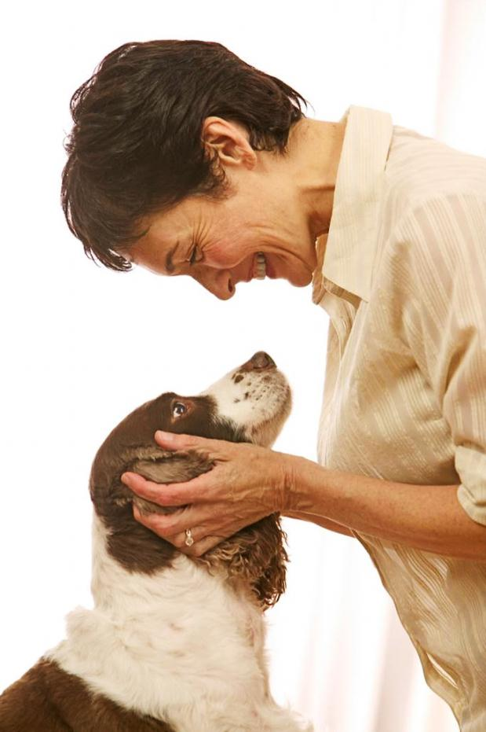
Mission
…to rescue, rehabilitate, and re-home stray or unwanted pets. Shelbyfield Animal Rescue dedicated to helping animals in need, and helping you find the perfect pet for your home.

Slide 3
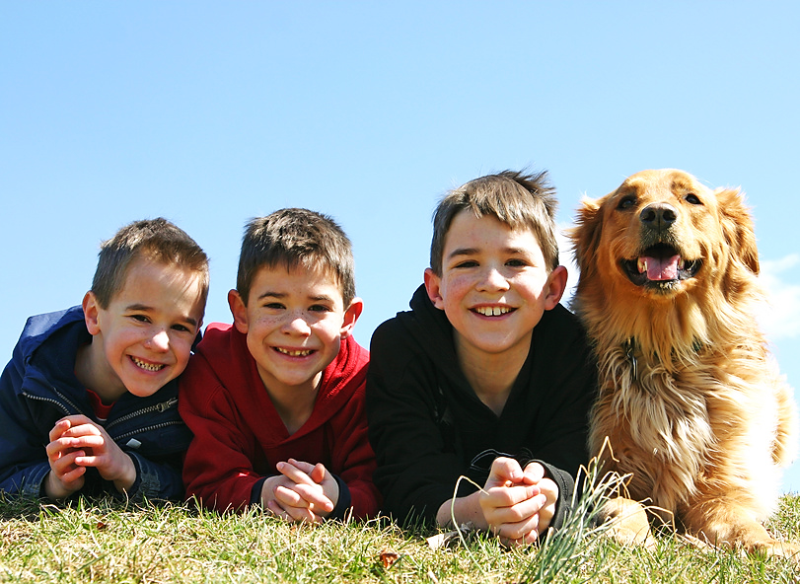
Man’s Best Friend
Adoptable Dogs

Slide 4
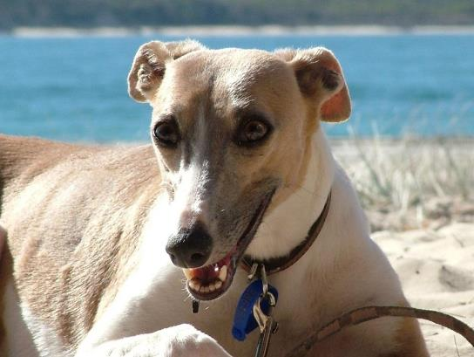
Franny
Female 30 lbs.
Whippet 5 yrs. old
Likes: Long walks on the beach
Dislikes: Drama

Slide 5
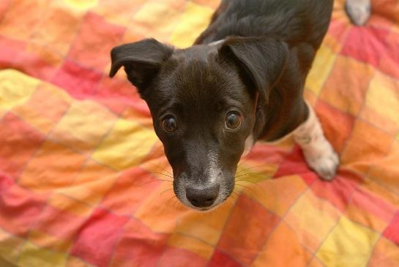
Zooey
Male 18 lbs.
Border Collie Mix 3 mos. old
Likes: Cookies
Dislikes: Fruits and vegetables

Slide 6
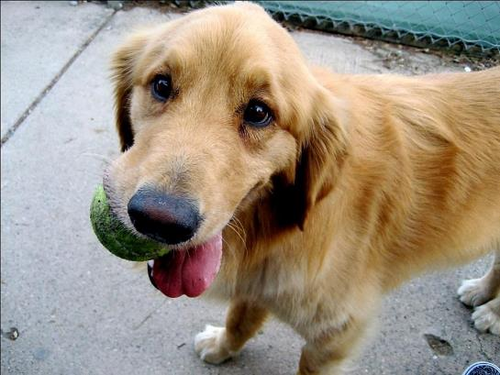
Salinger
Male 72 lbs.
Golden Retriever 3 yrs. old
Likes: Filthy tennis balls
Dislikes: Clean tennis balls

