Slide 1
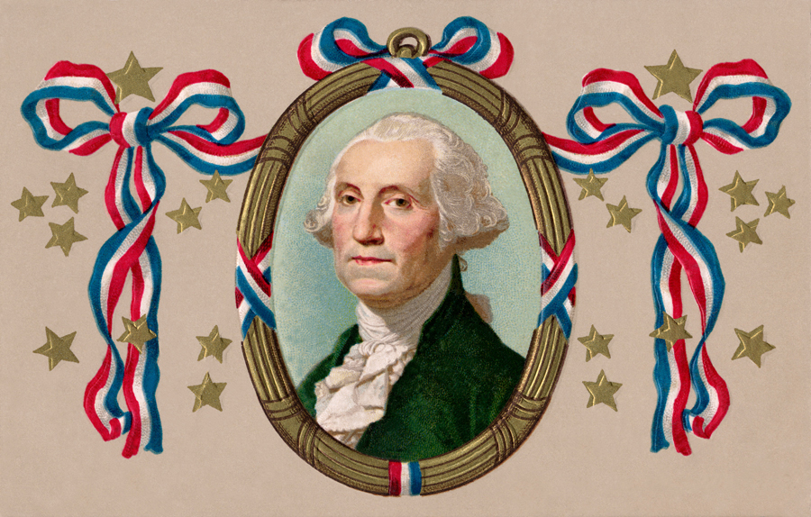
American History
Flash Cards

Slide 2
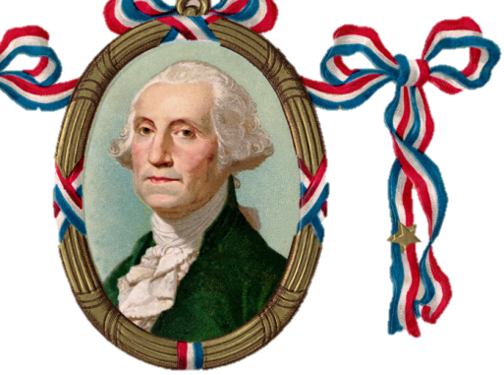
Question 1
Why did the colonists fight the British?

Slide 3
because of high taxes
(taxation without representation)
because the British stayed in their houses (boarding, quartering)
because they didn’t have self-government

Slide 4
Question 2
Who wrote the Declaration of Independence,
and when was it adopted?

Slide 5
Thomas Jefferson
July 4, 1776

Slide 6
Question 3
Under the pseudonym “Publius,” who wrote the
Federalist Papers?

Slide 7
Alexander Hamilton
James Madison
John Jay

Slide 8
Don’t forget to be A
Study
Take notes
Ask questions
Review with a friend
S T A R

